Slide 1


Get_Doctors
Get_Doctors
Book your doctor appointment hassle-free with our convenient online platform, allowing you to schedule consultations in just a few clicks.
Created By :
Sahil Patel - 176
Kevin Patel - 105
Project Guide :
Dr. Hinal Prajapati
Dr. Tushar Parikh

Slide 2
Get_Doctors
DFD(Data Flow Diagram)
A Data Flow Diagram (DFD) is a visual representation illustrating the flow of data within a system, showing how information moves from input to processing to output. It simplifies complex processes by highlighting data exchanges and transformations in a structured manner.
Context Level DFD :- Level-0
Request
Request
0.0
Get_Doctors
DOCTOR
PATIENT
Response
Response
Request
Response
ADMIN

Slide 3
Get_Doctors
First Level DFD :- Level-1 (ADMIN)
ADMIN
1.1
Login
1.2
Add Doctor
1.3
Show Patient
1.4
Show Doctor
1.5
Show
Appointment
1.6
Genetare
Report
1.7
Logout
Req
Res
Req
Res
Req
Res
Req
Res
Req
Res
Req
Res
ADMIN
DOCTOR
PATIENT
DOCTOR
APPOINTMENT
PATIENT, DOCTOR, APPOINTMENT

Slide 4
Get_Doctors
First Level DFD :- Level-1 (DOCTOR)
DOCTOR
1.1
Login
1.2
Manage Profile
1.3
Show
Appointment
1.4
Show Doctor
1.4
Genetare
Report
1.5
Show ALL
Patient
1.6
Logout
Req
Res
Req
Res
Req
Res
Req
Res
Req
Res
DOCTOR
DOCTOR
APPOINTMENT, PATIENT
APPOINTMENT, PATIENT
PATIENT, APPOINTMENT

Slide 5
Get_Doctors
First Level DFD :- Level-1 (PATIENT)
PATIENT
1.1
Login
Registration
1.3
Select Specialization
1.5
Book
Appointment
1.6
Genetare
Report
1.2
Manage Profile
1.4
Select Doctor
1.7
Logout
Req
Res
Req
Res
Req
Res
Req
Res
Req
Res
Req
Res
PATIENT
PATIENT
SPECIALIZATION
DOCTOR
APPOINTMENT
APPOINTMENT

Slide 6
Get_Doctors
Data Dictionary
A data dictionary is a centralized repository that provides detailed descriptions of data attributes within a database or system, facilitating understanding and management of data elements and their relationships. It serves as a comprehensive reference guide for data structure, organization, and usage.
Specialization Table:-
Field_Name | Data_Type | Size | Constrain | Description
SID | INT | 3 | PRIMARY KEY | SPECIALIZATION ID
SPECIALIZATION | VARCHAR | 35 | NOT NULL | DOCTOR SPECIALIZATION

Slide 7
Get_Doctors
Admin Table:-
Field_Name | Data_Type | Size | Constrain | Description
AID | INT | 3 | PRIMARY KEY | ADMIN ID
APHOTO | LONGBLOB | - | NOT NULL | ADMIN PHOTO
ANAME | VARCHAR | 25 | NOT NULL | ADMIN NAME
APASSWORD | VARCHAR | 20 | NOT NULL | ADMIN PASSWORD
AEMAIL | VARCHAR | 35 | NOT NULL | ADMIN EMAIL
ALAST_PASSWORD_CHANGE | DATE | - | NOT NULL | ADMIN LAST TIME PASSWORD CHANGE
ANUMBER | INT | 10 | NOT NULL | ADMIN NUMBER
AADDRESS | VARCHAR | 50 | NOT NULL | ADMIN ADDRESS

Slide 8
Get_Doctors
Doctor Table:-
Field_Name | Data_Type | Size | Constrain | Description
DID | INT | 3 | PRIMARY KEY | DOCTOR ID
DPHOTO | LONGBLOB |  | NOT NULL | DOCTOR PHOTO
DNAME | VARCHAR | 35 | NOT NULL | DOCTOR NAME
DPASSWORD | VARCHAR | 20 | NOT NULL | DOCTOR PASSWORD
DEMAIL | VARCHAR | 35 | NOT NULL | DOCTOR EMAIL
DGENDER | VARCHAR | 10 | NOT NULL | DOCTOR GENDER
DNUMBER | INT | 10 | NOT NULL | DOCTOR NUMBER
DADDRESS | VARCHAR | 50 | NOT NULL | DOCTOR ADDRESS
SID | INT | 3 | FOREIGN KRY | DOCTOR SPECIALIZATION
DDATE_OF_BIRTH | DATE | - | NOTNULL | DOCTOR DATE OF BIRTH
DCONSULTATION_FEE | INT | 10 | NOT NULLL | DOCTOR FEES
DEXPERIENCE_YEARS | INT | 2 | NOT NULL | DOCTOR EXPERIENCE YEAR
DQUALIFICATION | VARCHAR | 50 | NOT NULL | DOCTOR QUALIFICATION

Slide 9
Get_Doctors
Patient Table:-
Field_Name | Data_Type | Size | Constrain | Description
PID | INT | 3 | PRIMARY KEY | PATIENT ID
PPHOTO | LONGBLOB |  | NOT NULL | PATIENT PHOTO
PNAME | VARCHAR | 35 | NOT NULL | PATIENT NAME
PPASSWORD | VARCHAR | 20 | NOT NULL | PATIENT PASSWORD
PEMAIL | VARCHAR | 35 | NOT NULL | PATIENT EMAIL
PGENDER | VARCHAR | 10 | NOT NULL | PATIENT GENDER
PNUMBER | INT | 10 | NOT NULL | PATIENT NUMBER
PADDRESS | VARCHAR | 50 | NOT NULL | PATIENT ADDRESS
PBLOOD_GROUP | VARCHAR | 3 | NOT NULL | PATIENT BLOOD GROUP
PDATE_OF_BIRTH | DATE | - | NOTNULL | PATIENT DATE OF BIRTH

Slide 10
Get_Doctors
Appointment Table:-
Field_Name | Data_Type | Size | Constrain | Description
ID | INT | 3 | PRIMARY KEY | APPOINTMENT ID
DID | INT | 3 | FOREIGN KRY | DOCTOR ID
PID | INT | 3 | FOREIGN KRY | PATIENT ID
APPOINTMENT_DATE | DATE | - | NOT NULL | APPOINTMENT DATE
APPOINTMENT_TIME | TIME | - | NOT NULL | APPOINTMENT TIME
SID | INT | 3 | FOREIGN KRY | SPECIALIZATION ID
FEES | INT | 5 | NOT NULL | BOOKING FEES
STATUS | BOOLEAN | - | NOT NULL | APPOINTMENT APPROVE OR NOT
FEEDBACK | VARCHAR | 100 | NULL | PATIENT REVIEW

Slide 11
Get_Doctors
ER Diagram (Entity Relationship Diagram) :-
An Entity-Relationship (ER) Diagram is a visual representation illustrating the entities, attributes, and relationships within a database system, aiding in the design and understanding of data structures and connections. It uses symbols to depict entities as rectangles, attributes as ovals, and relationships as lines connecting them, facilitating database schema design and communication between stakeholders.
AEMAIL
ANUMBER
AADDRESS
AID
ADMIN MANAGE APPOINTMENT
ANAME
ADMIN
DOCTOR SELECT SPECIALIZATIOON
APASSWORD
DEMAIL
DNUMBER
DADDRESS
ADMIN MANAGE DOCTOR
FEES
STATUS
FEEDBACK
DID
APPOINTMENT_DATE
DNAME
DOCTOR
SPECIALIZATION
APPOINTMENT
APPOINTMENT_TIME
DPASSWORD
SID
SID
DEXPERIENCE
YEAR
DQULIFICATION
DID
PID
ID
PID
DOCTOR,
PATIENT SHOW APPOINTMENT
PNAME
PATIENT
PPASSWORD
PEMAIL
PNUMBER
PADDRESS

Slide 12
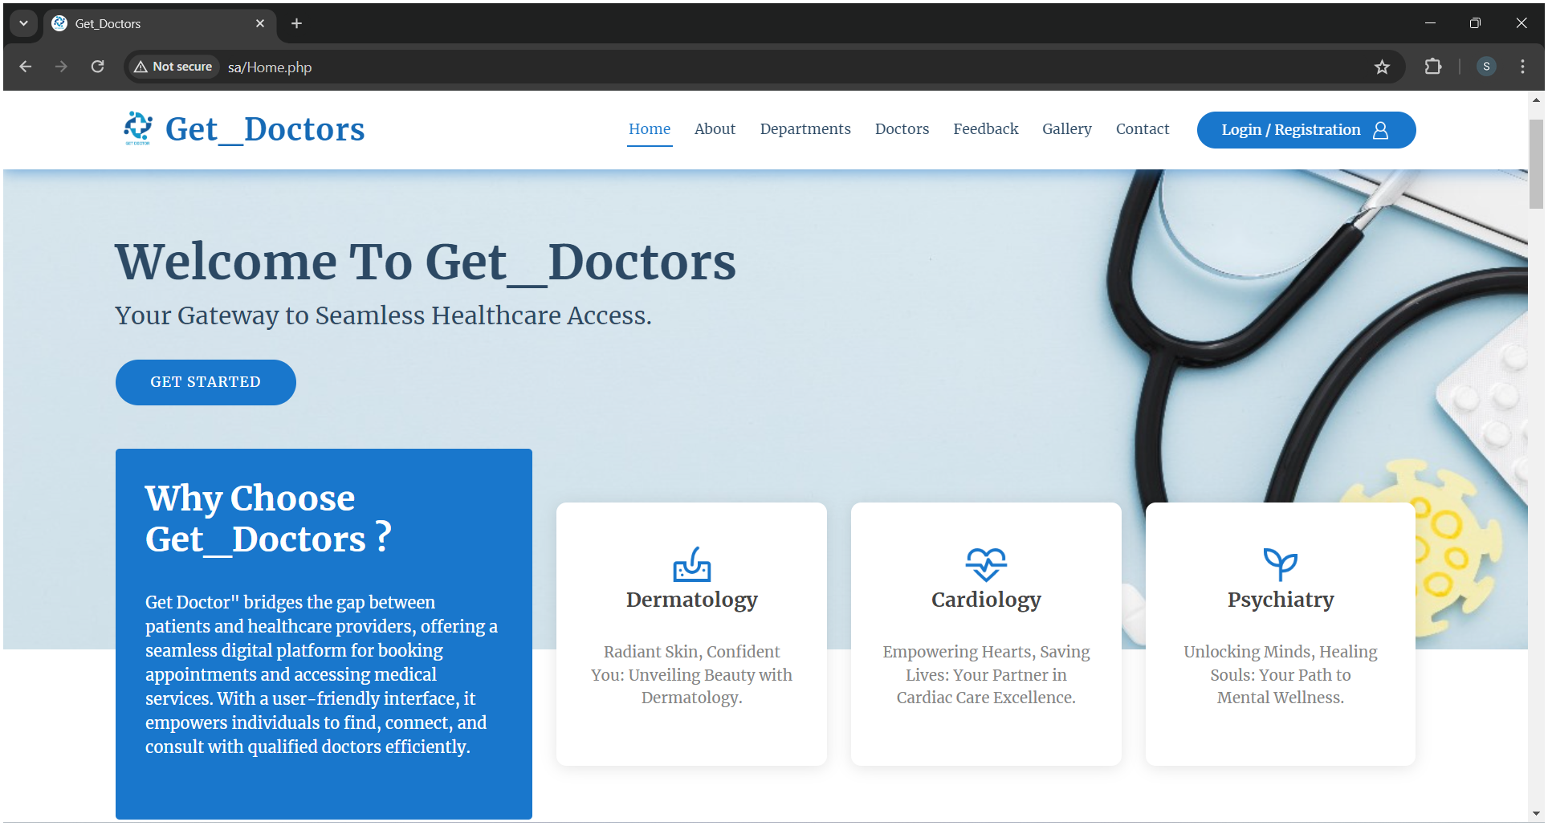
Get_Doctors
Interface Design
Interface design is the process of creating visually appealing and user-friendly layouts for digital platforms or applications, enhancing user interaction and experience.
Home

Slide 13
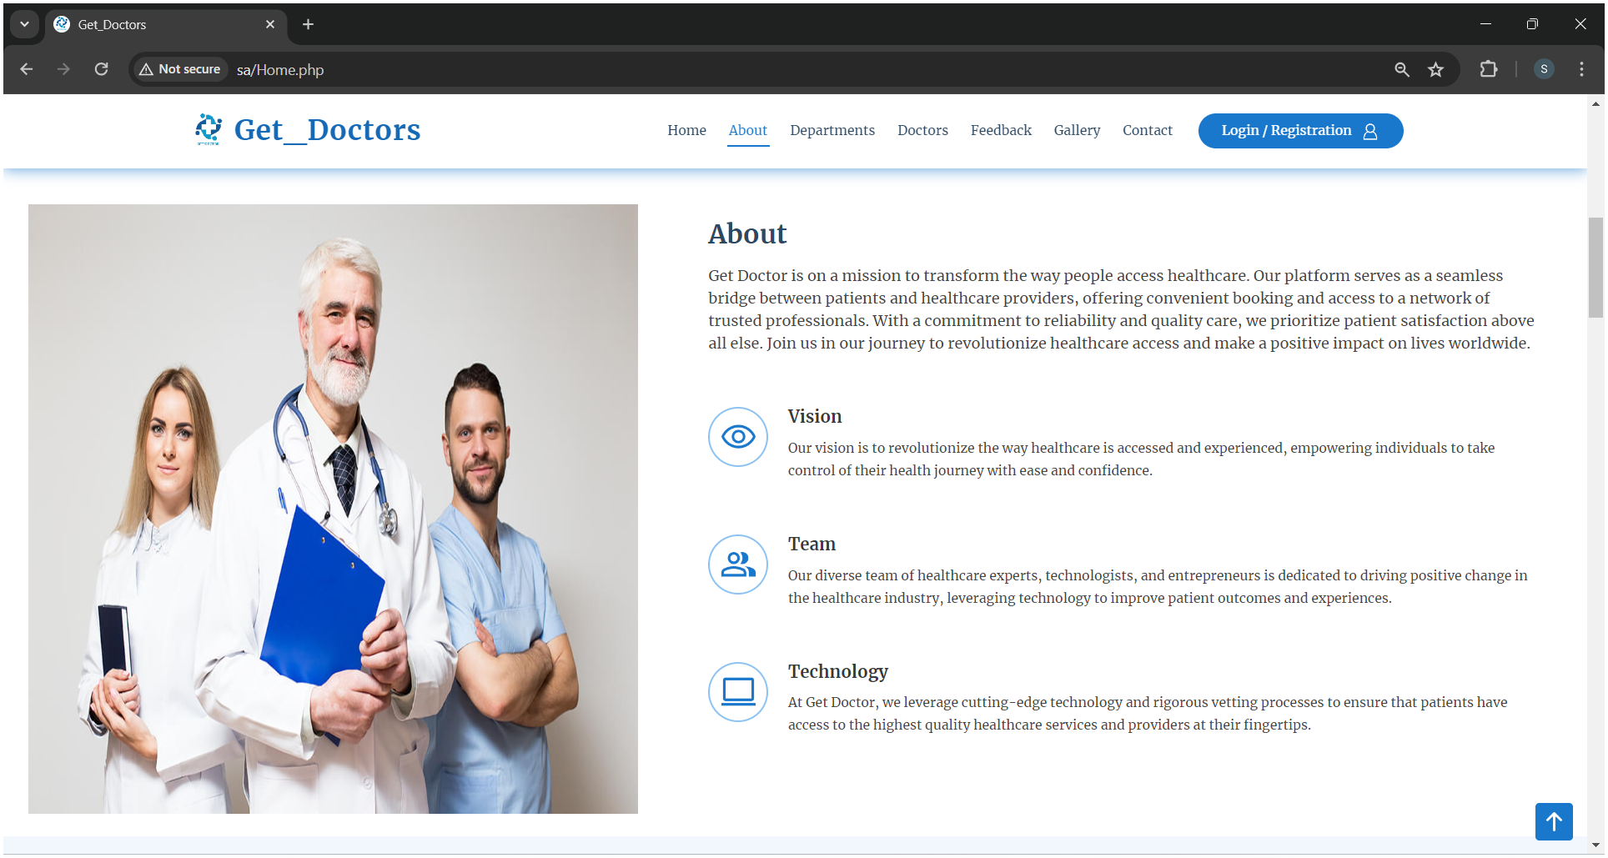
Get_Doctors
About

Slide 14
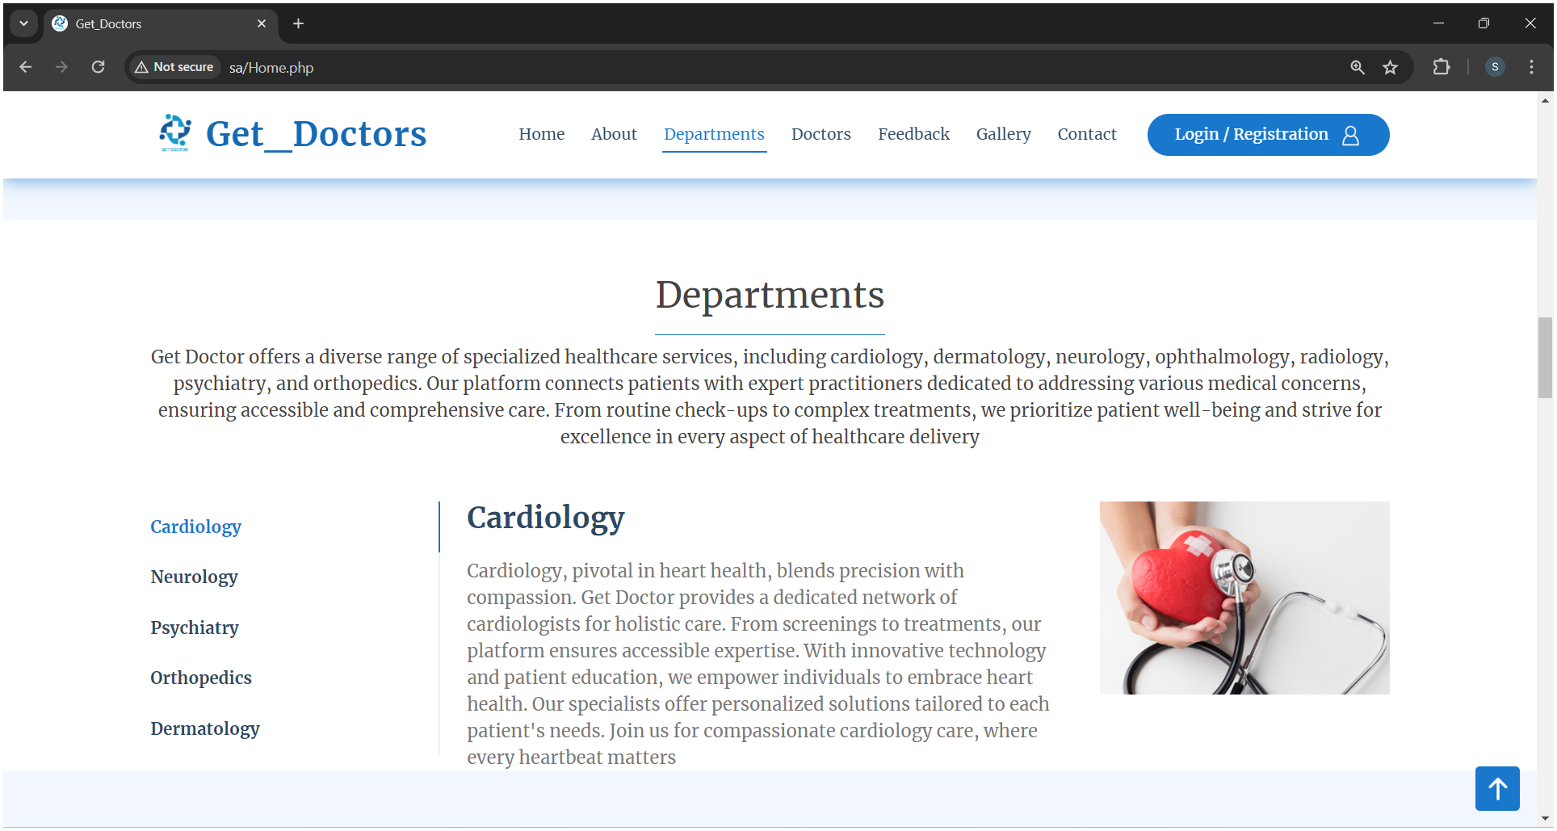
Get_Doctors
Departments

Slide 15
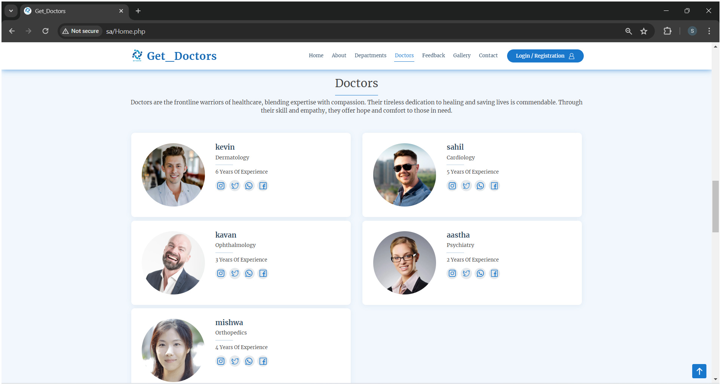
Get_Doctors
Doctors

Slide 16
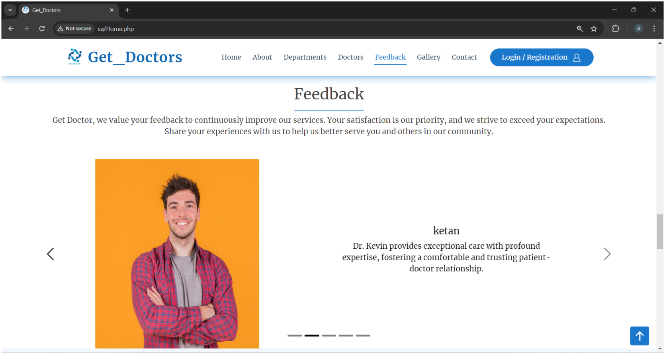
Get_Doctors
Feedback

Slide 17
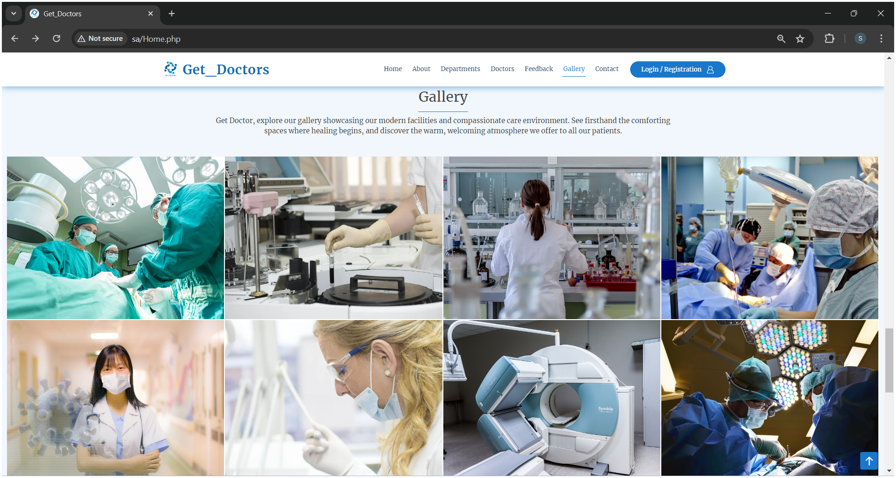
Get_Doctors
Gallery

Slide 18
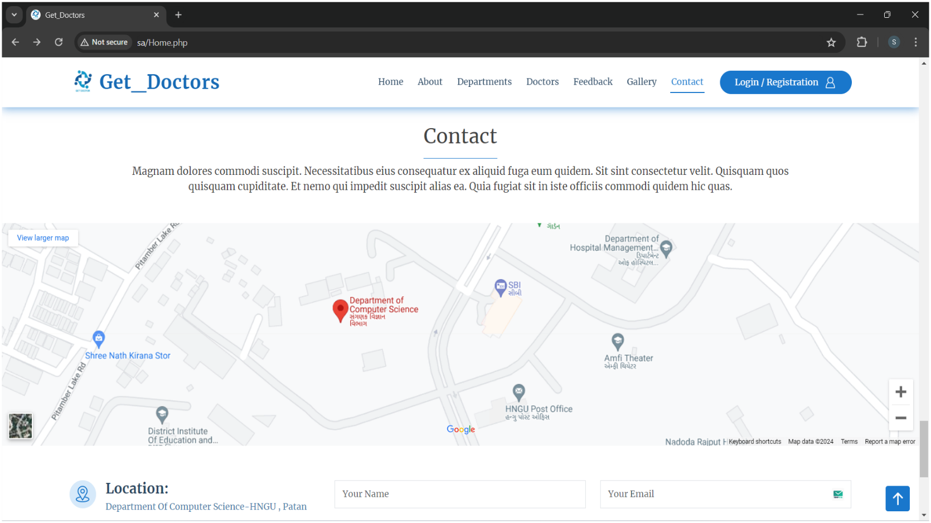
Get_Doctors
Contact

Slide 19
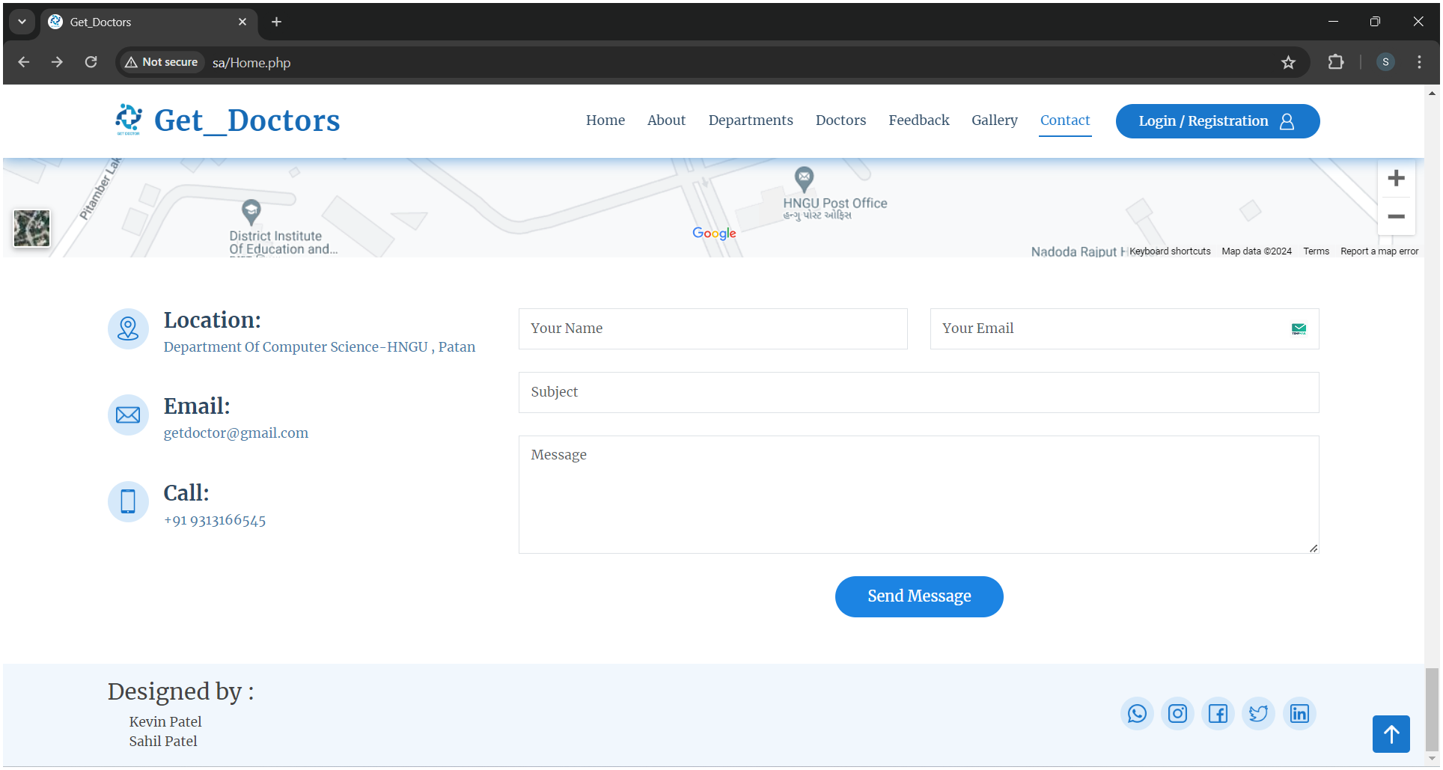
Get_Doctors
Contact Page Scroll up

Slide 20
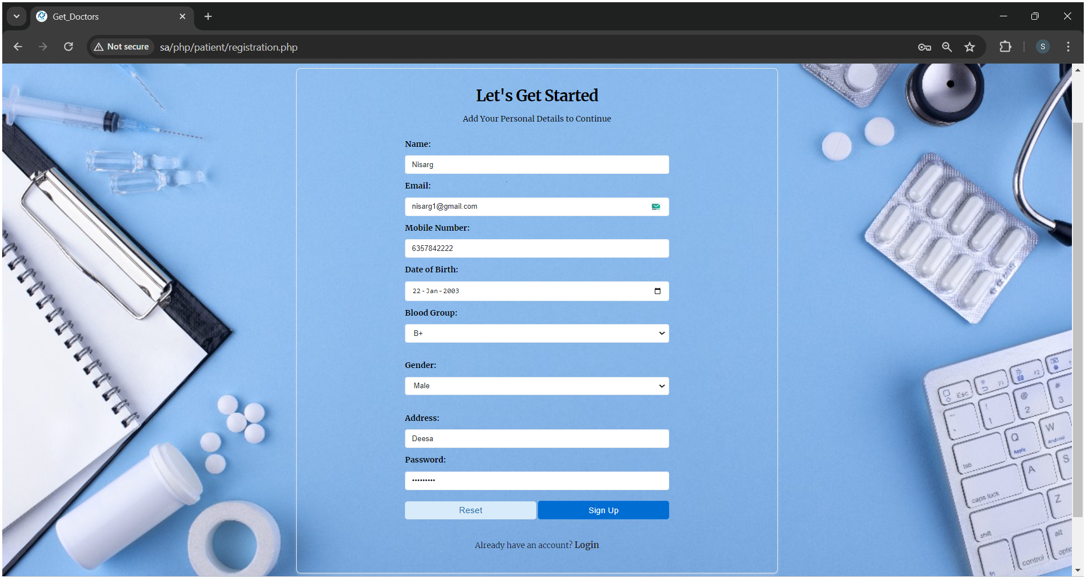
Get_Doctors
Patient Module :-
Registration

Slide 21
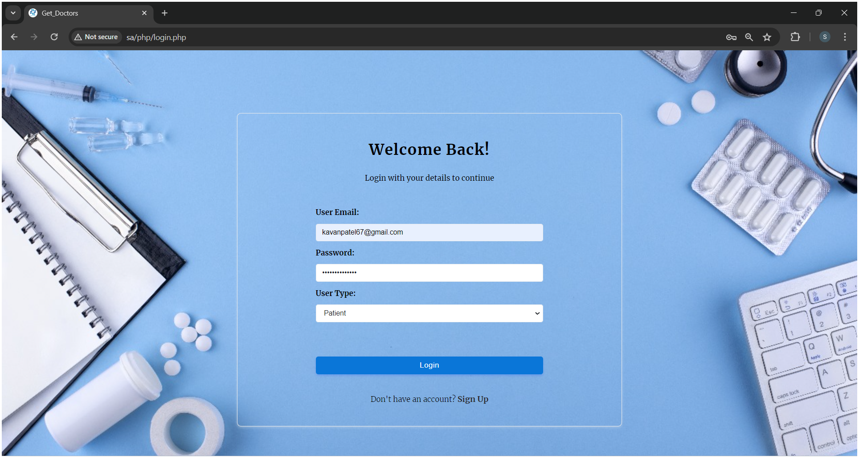
Get_Doctors
Login

Slide 22
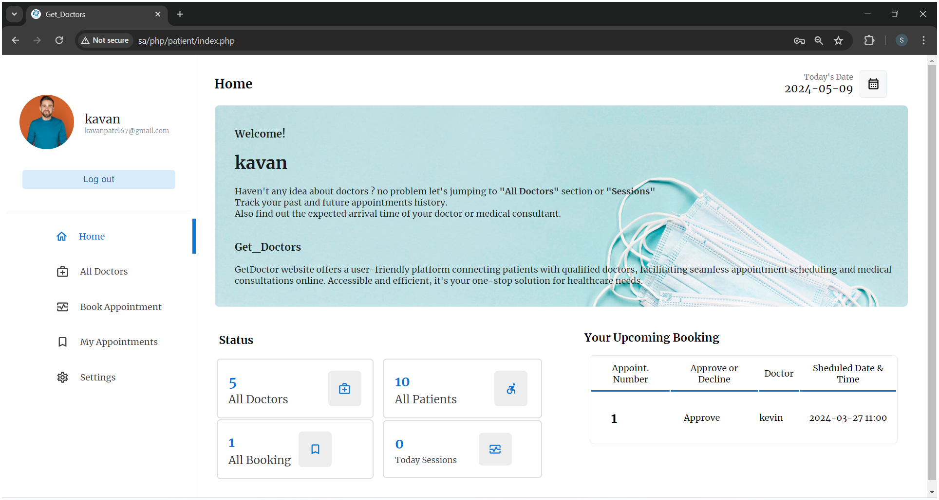
Get_Doctors
Home

Slide 23
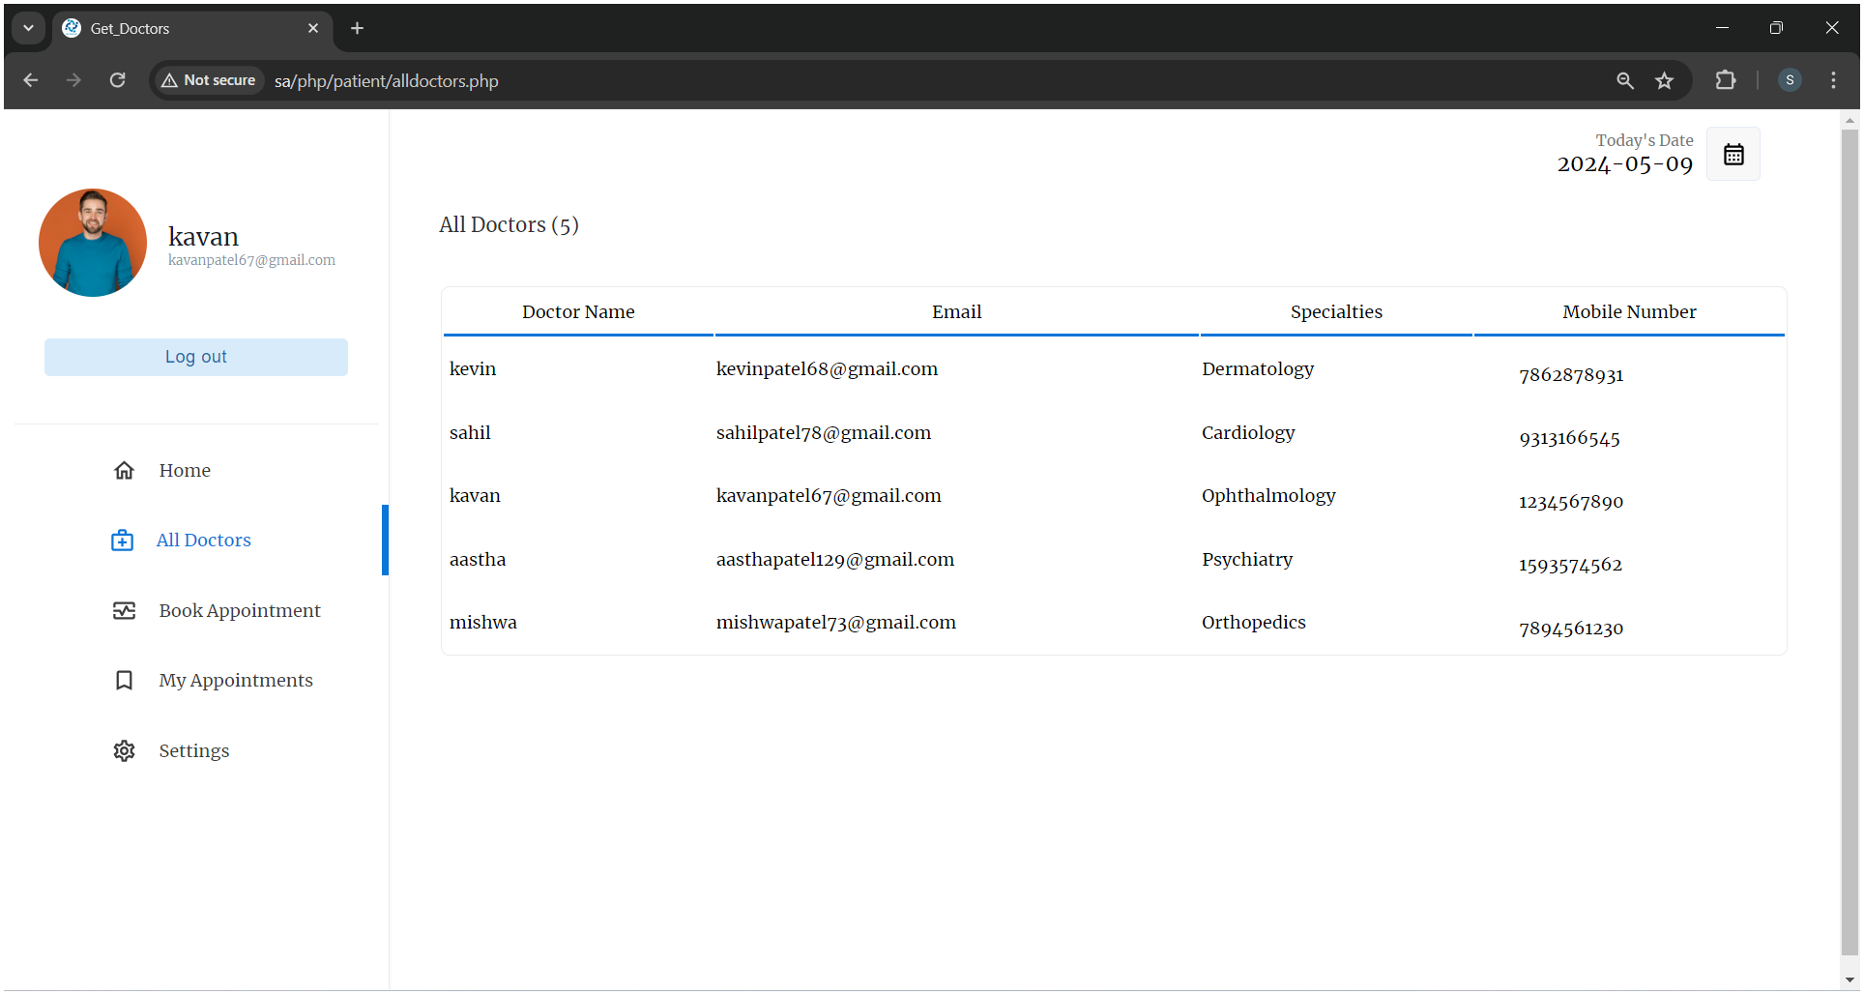
Get_Doctors
Show All Doctor

Slide 24
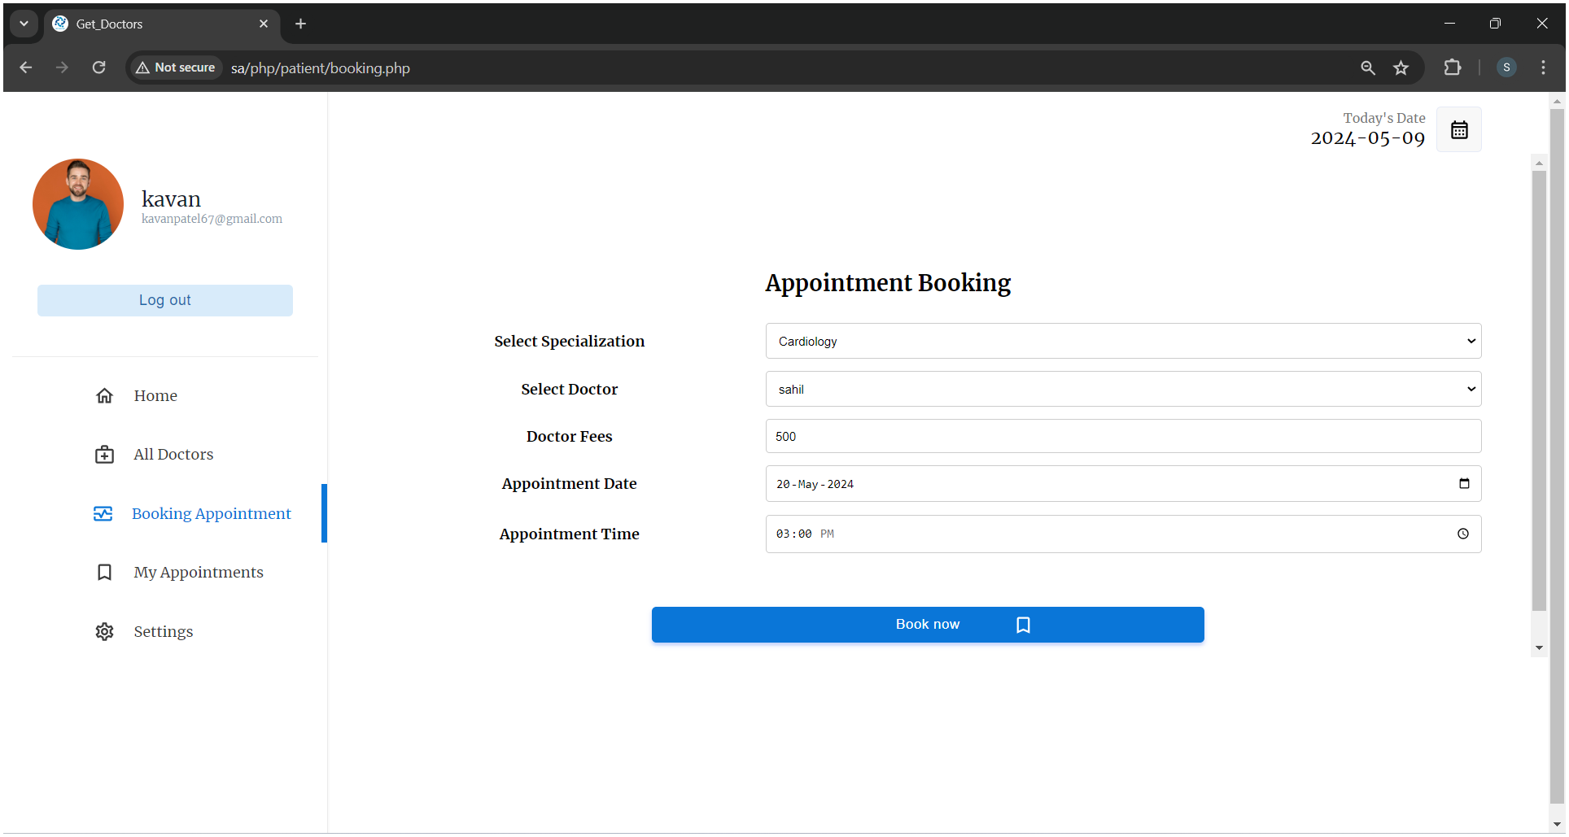
Get_Doctors
Appointment Booking

Slide 25
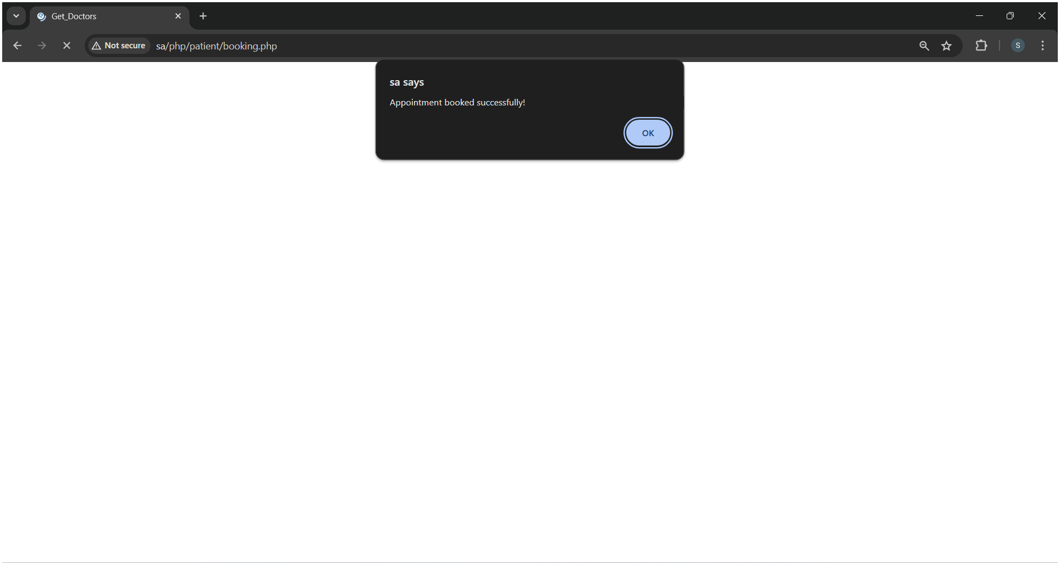
Get_Doctors
Appointment Booked Successfully

Slide 26
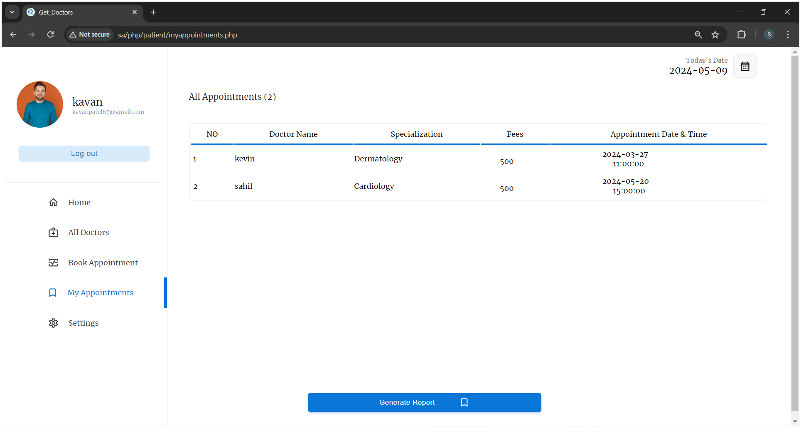
Get_Doctors
My Appointments

Slide 27
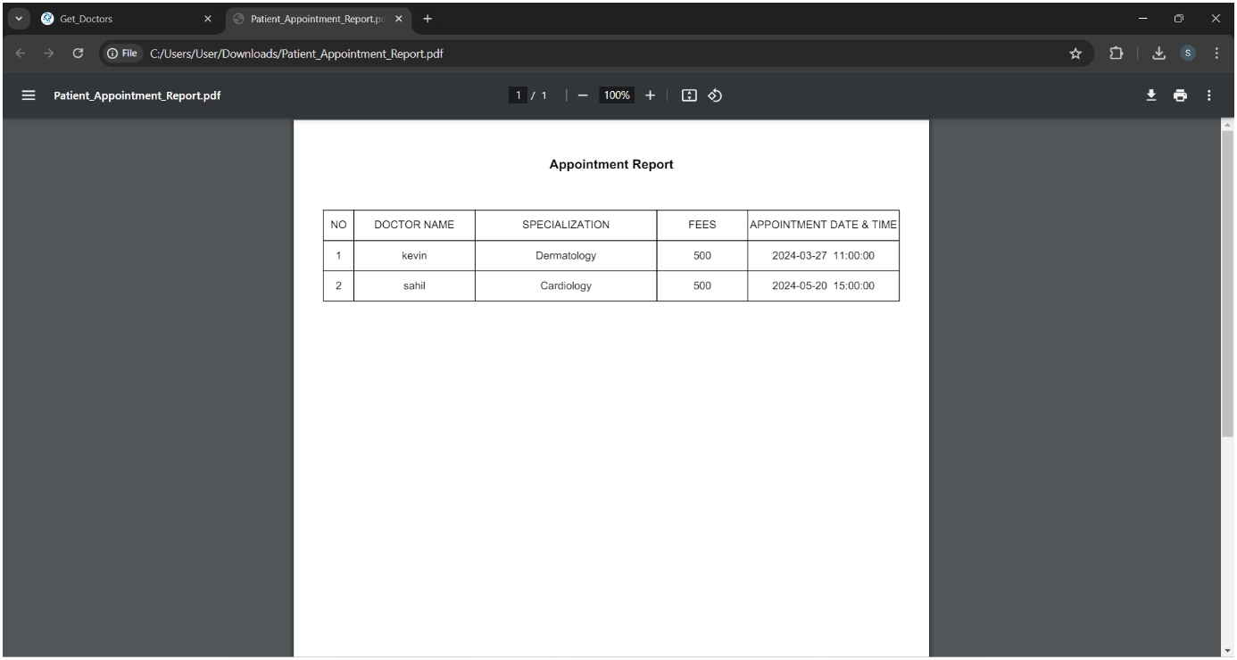
Get_Doctors
Appointments Report

Slide 28
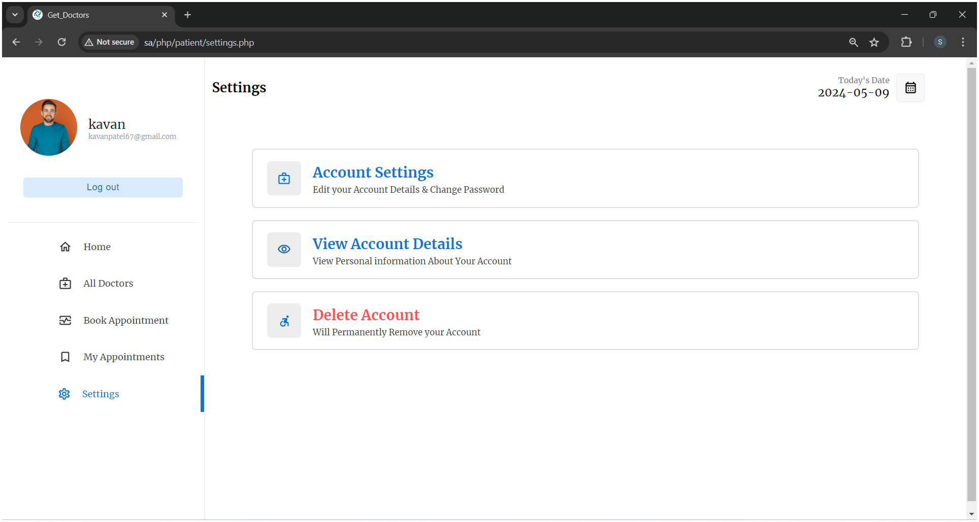
Get_Doctors
Setting

Slide 29
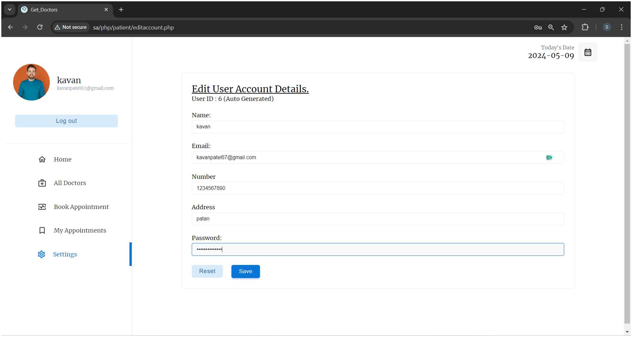
Get_Doctors
Edit Account Details

Slide 30
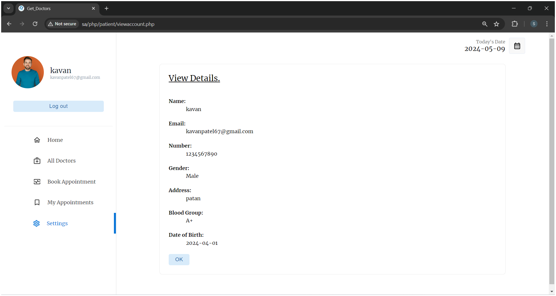
Get_Doctors
View Account Details

Slide 31
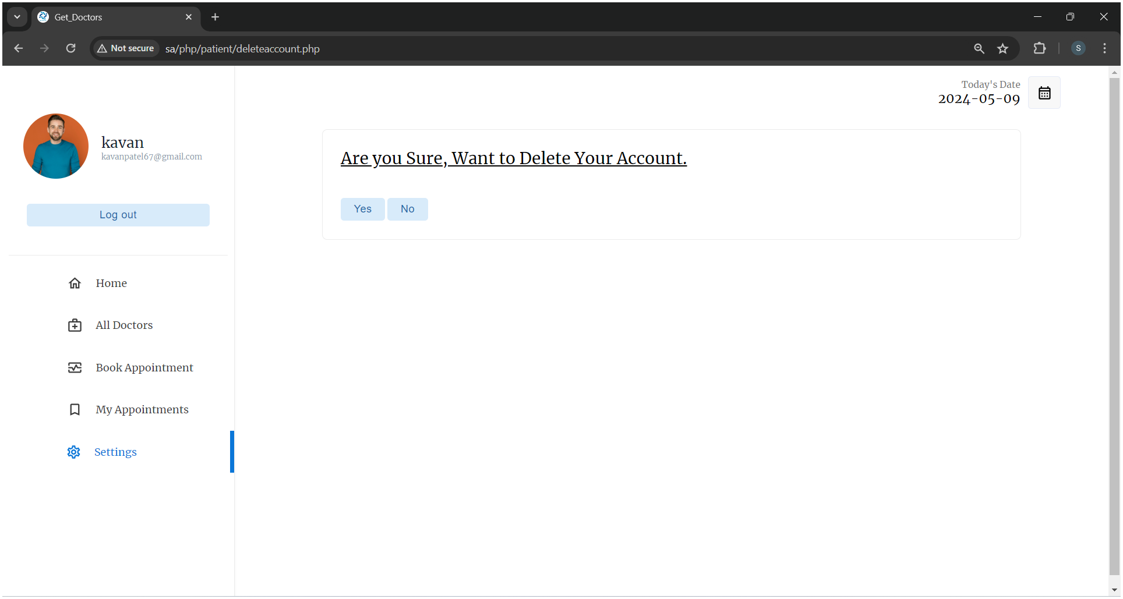
Get_Doctors
Delete Account

Slide 32

Get_Doctors
Doctor Module :-
Login

Slide 33
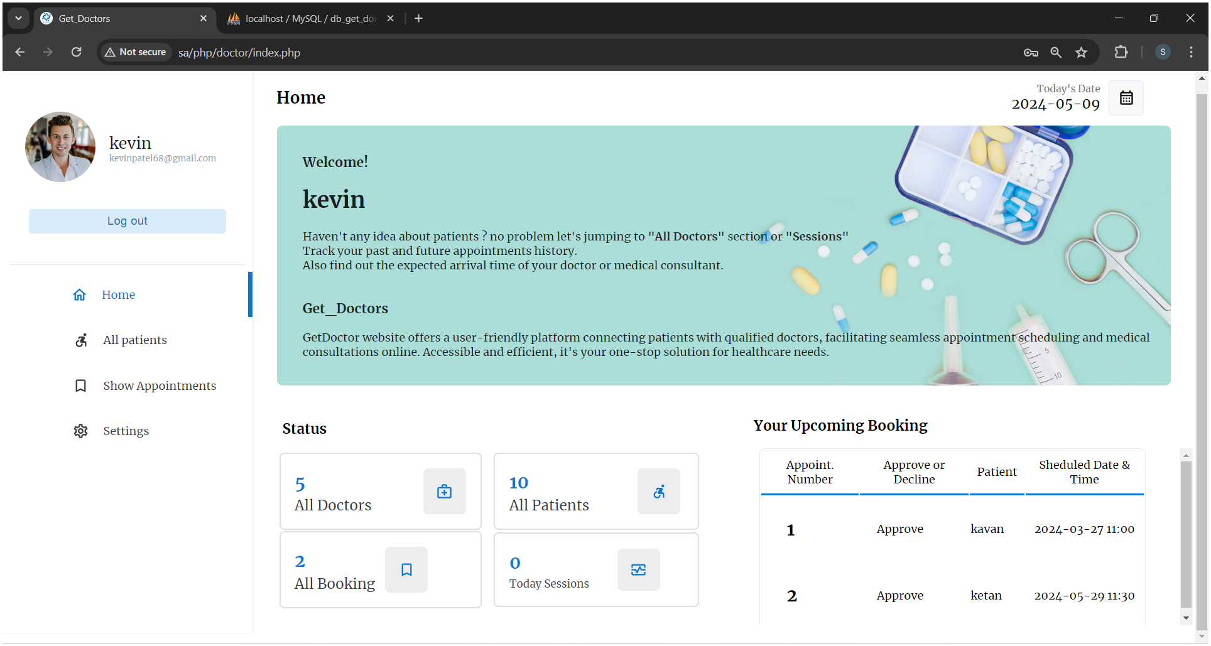
Get_Doctors
Home

Slide 34
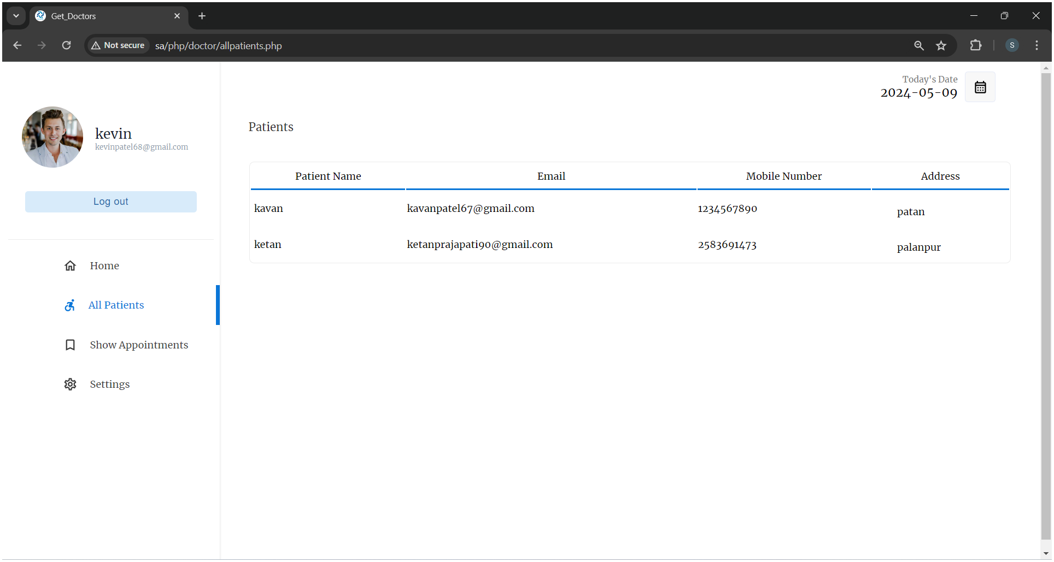
Get_Doctors
Show All Patients

Slide 35
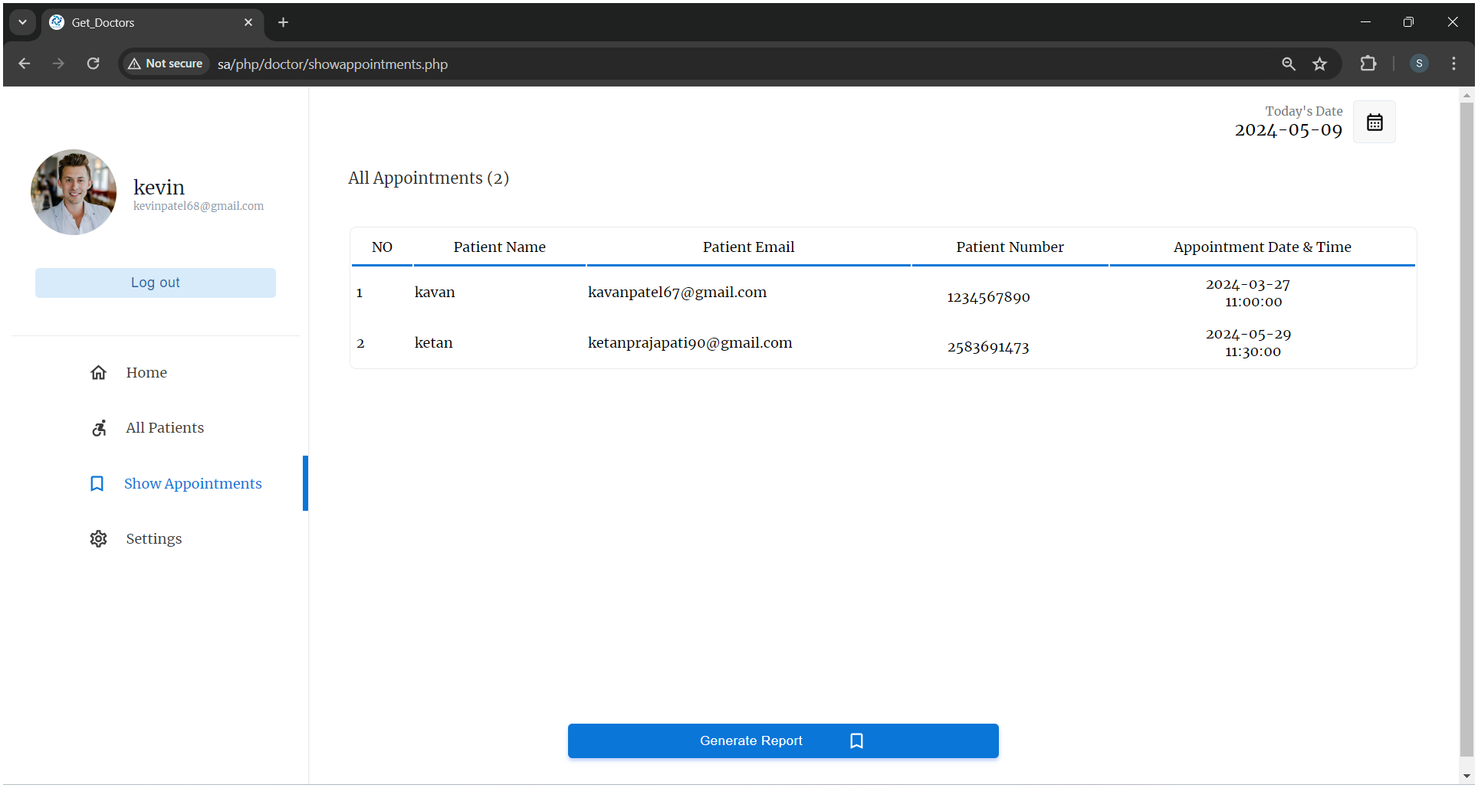
Get_Doctors
Show All Appointments

Slide 36
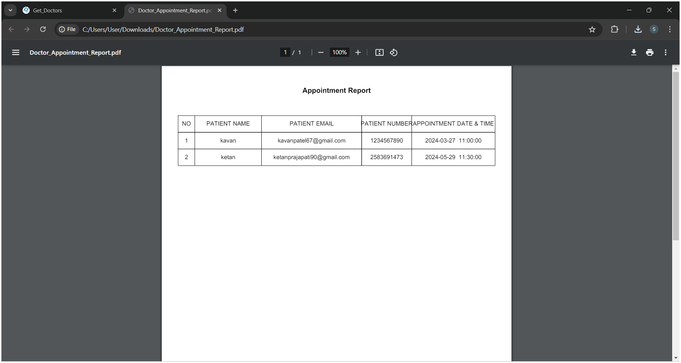
Get_Doctors
Appointments Report

Slide 37
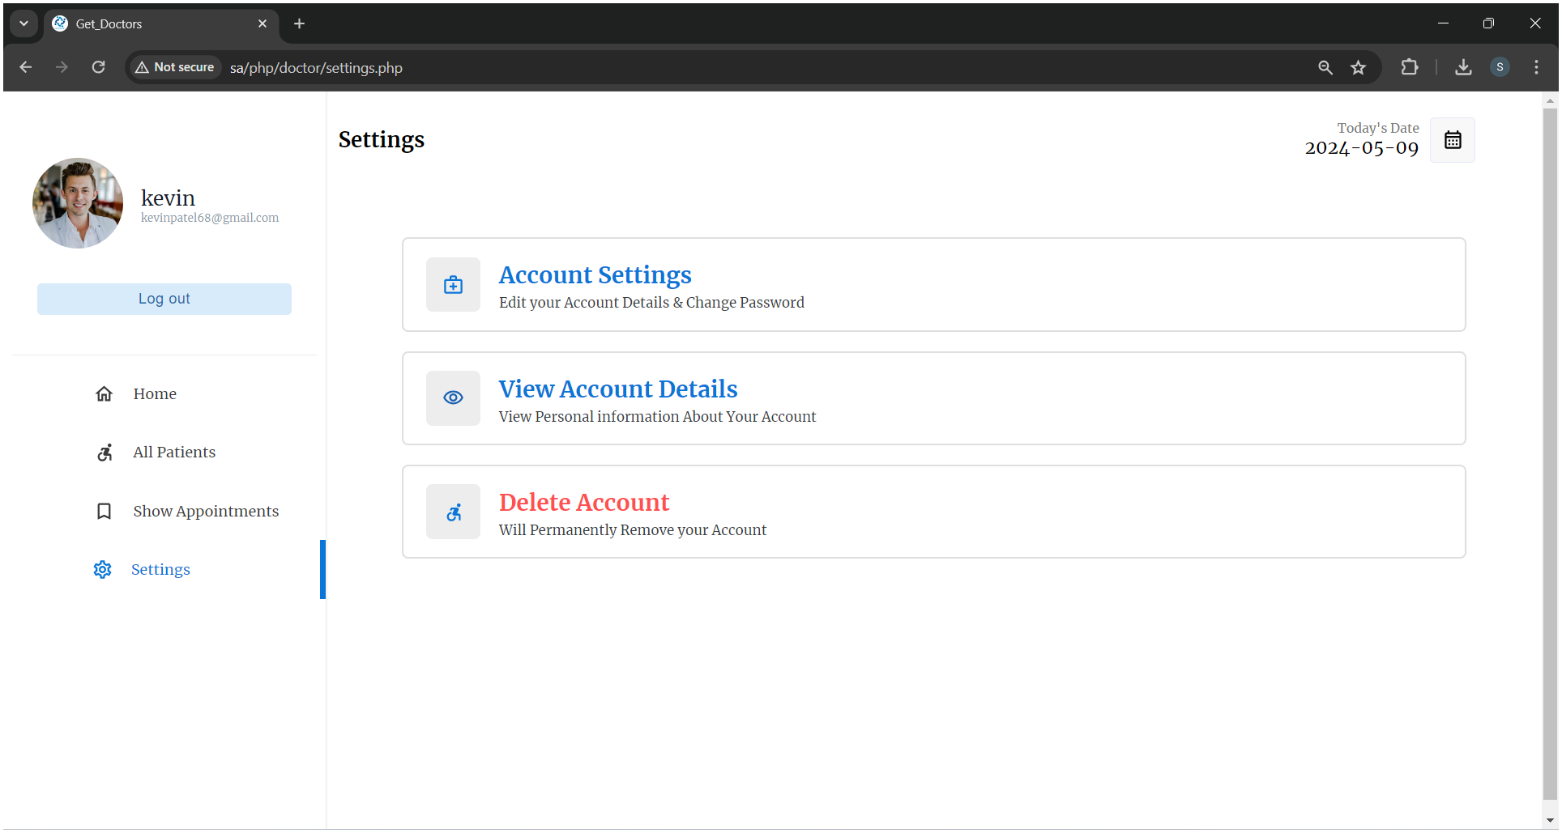
Get_Doctors
Settings

Slide 38
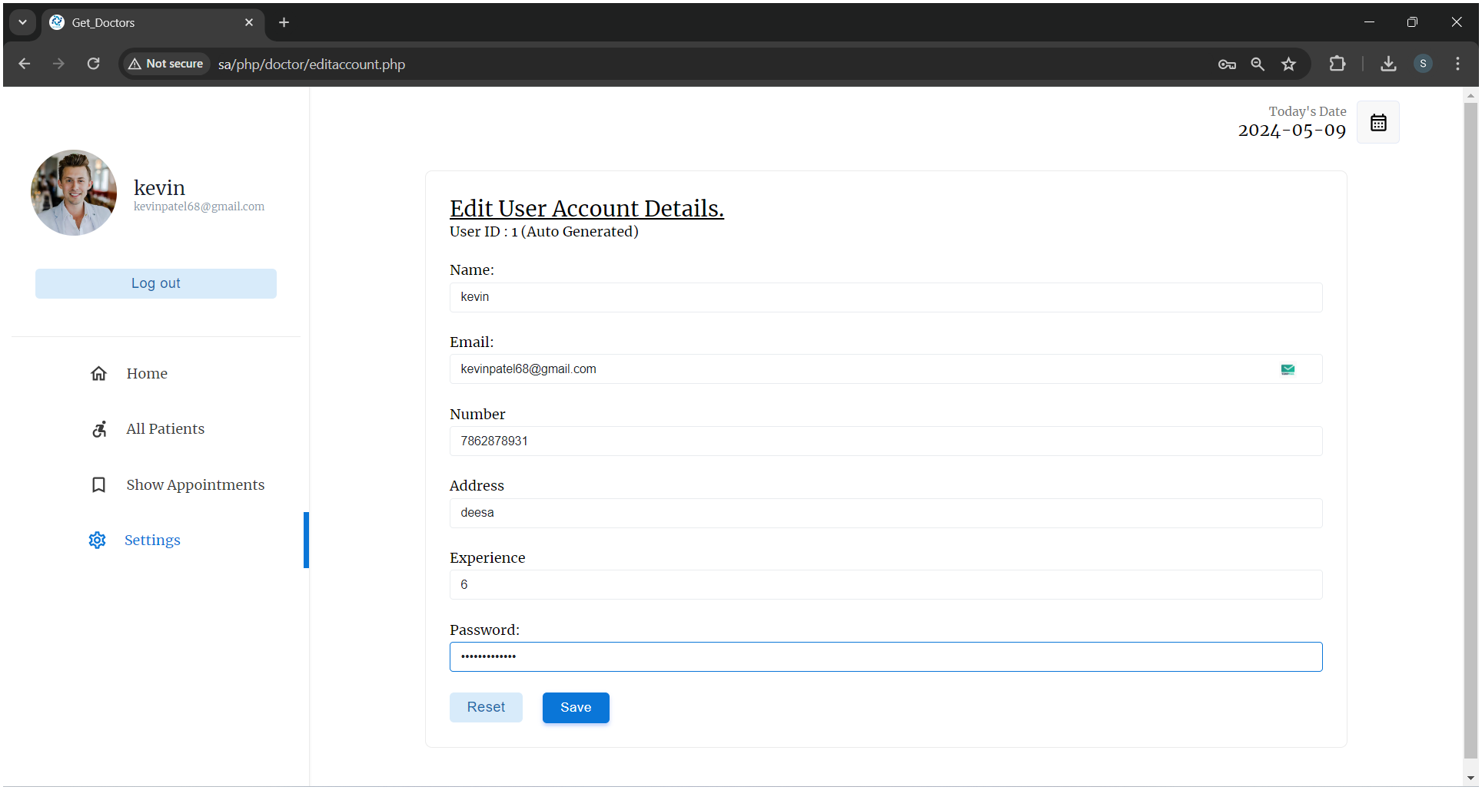
Get_Doctors
Edit Account Details

Slide 39
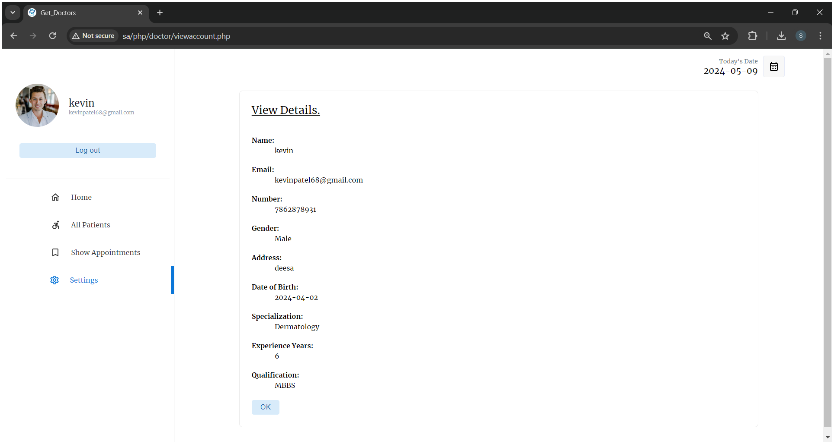
Get_Doctors
View Account Details

Slide 40
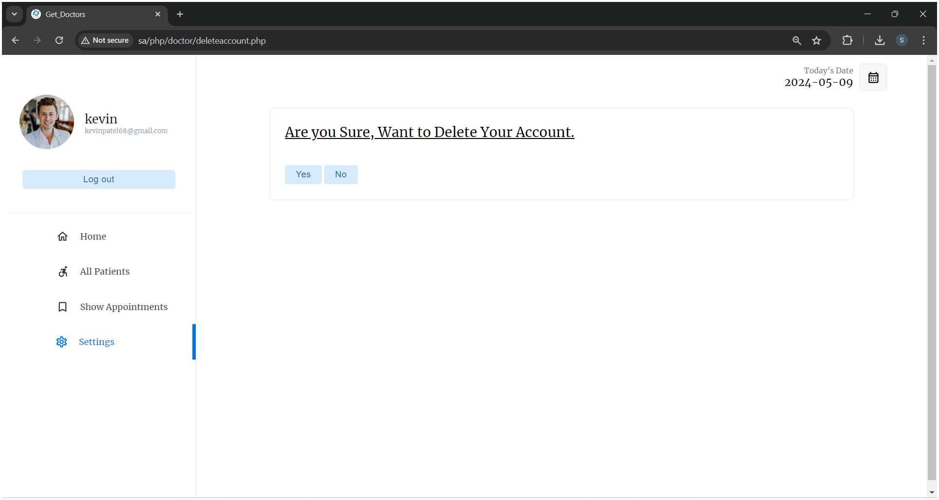
Get_Doctors
Delete Account

Slide 41

Get_Doctors
Admin Module :-
Login

Slide 42
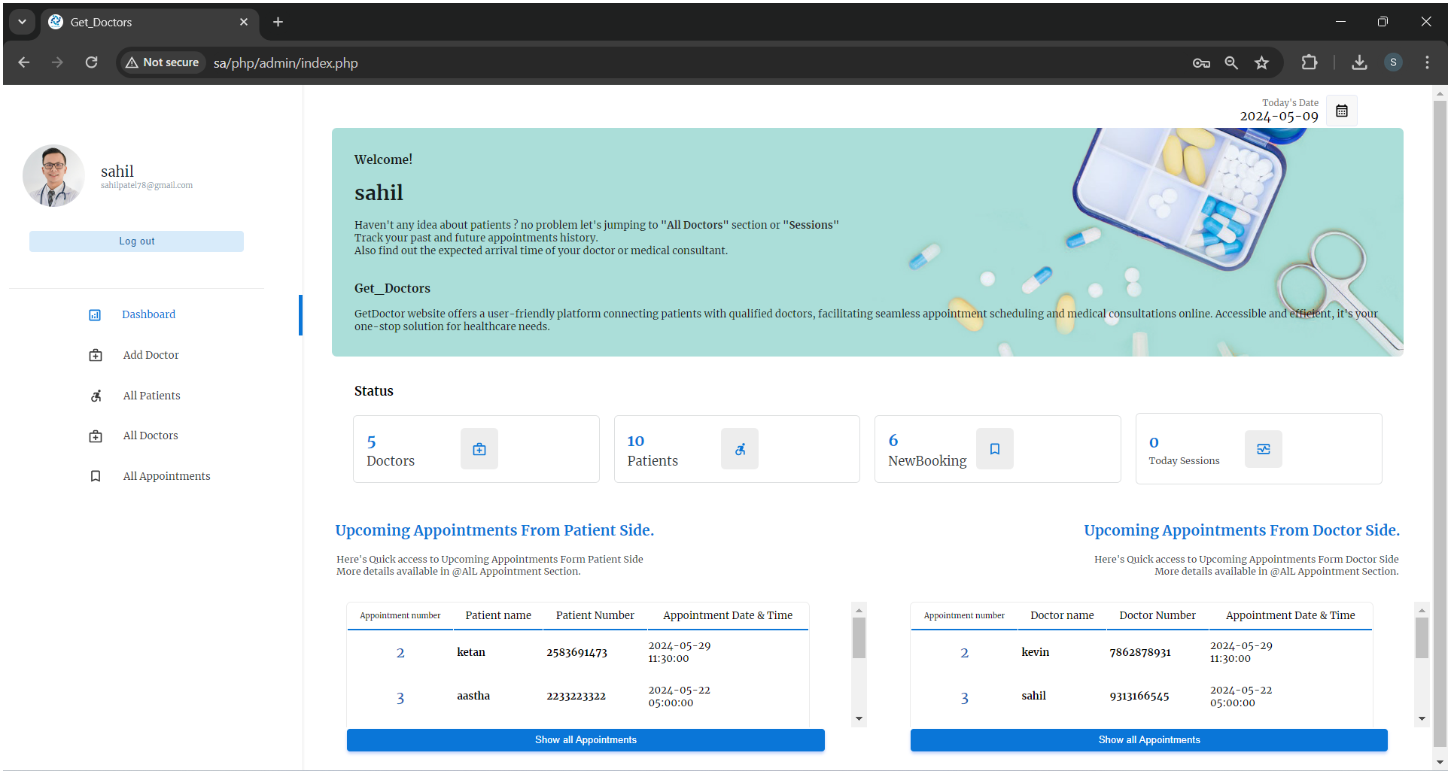
Get_Doctors
Home

Slide 43
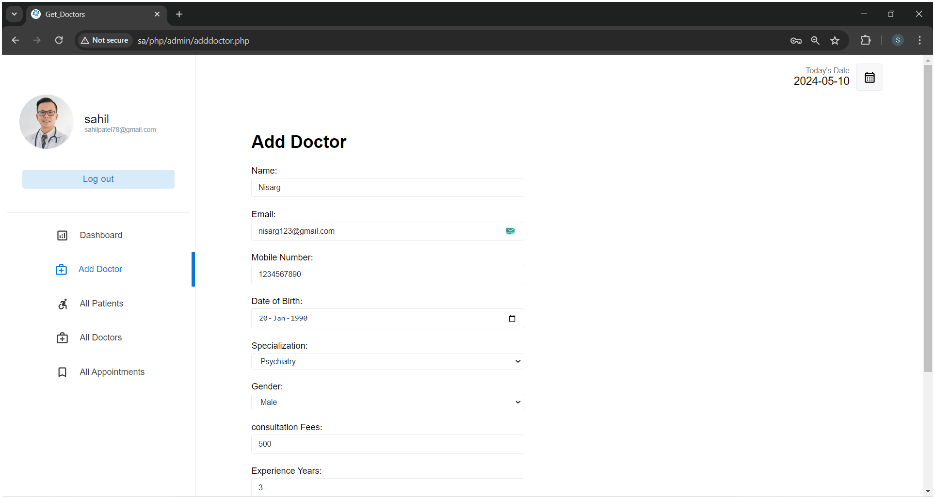
Get_Doctors
Add Doctor

Slide 44
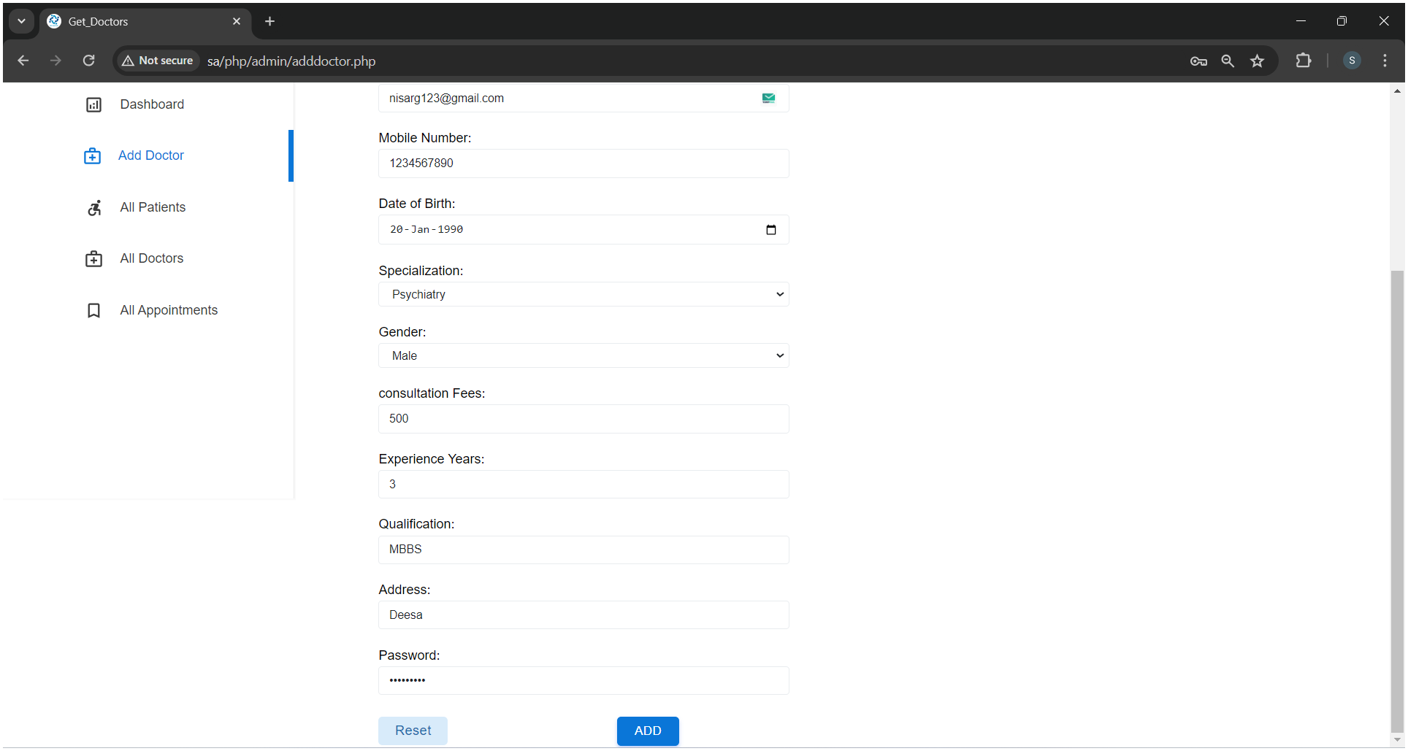
Get_Doctors
Add Doctor Scroll up

Slide 45
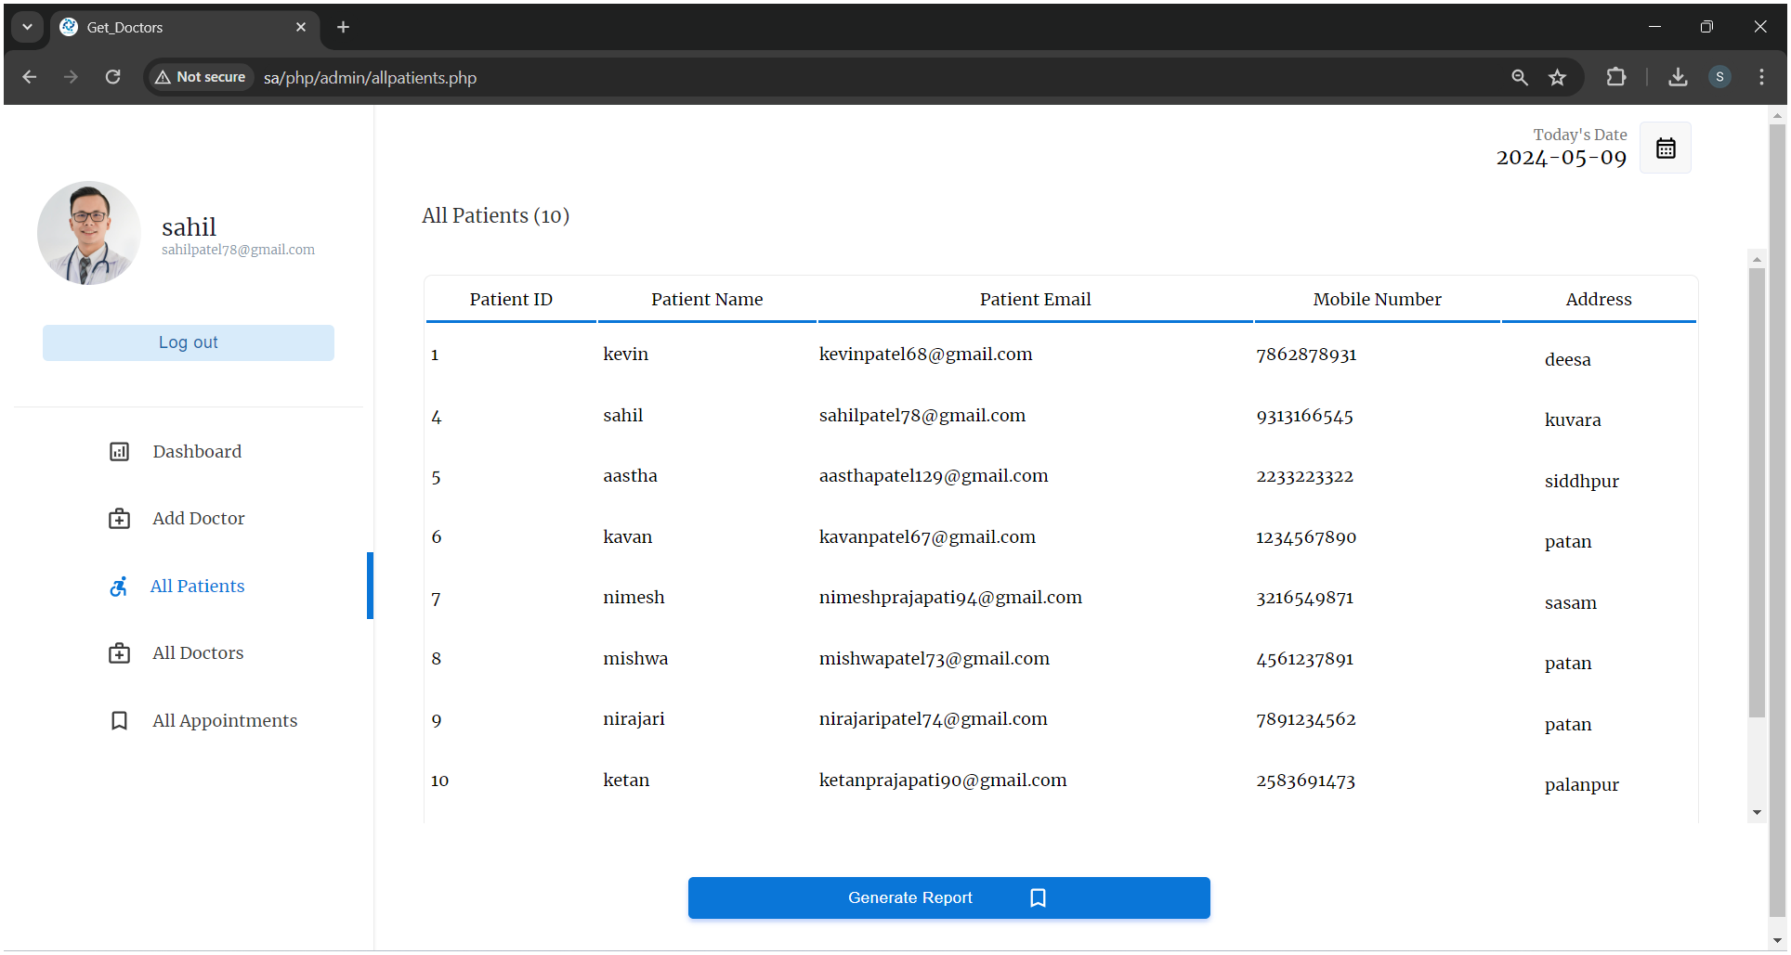
Get_Doctors
All Patients

Slide 46
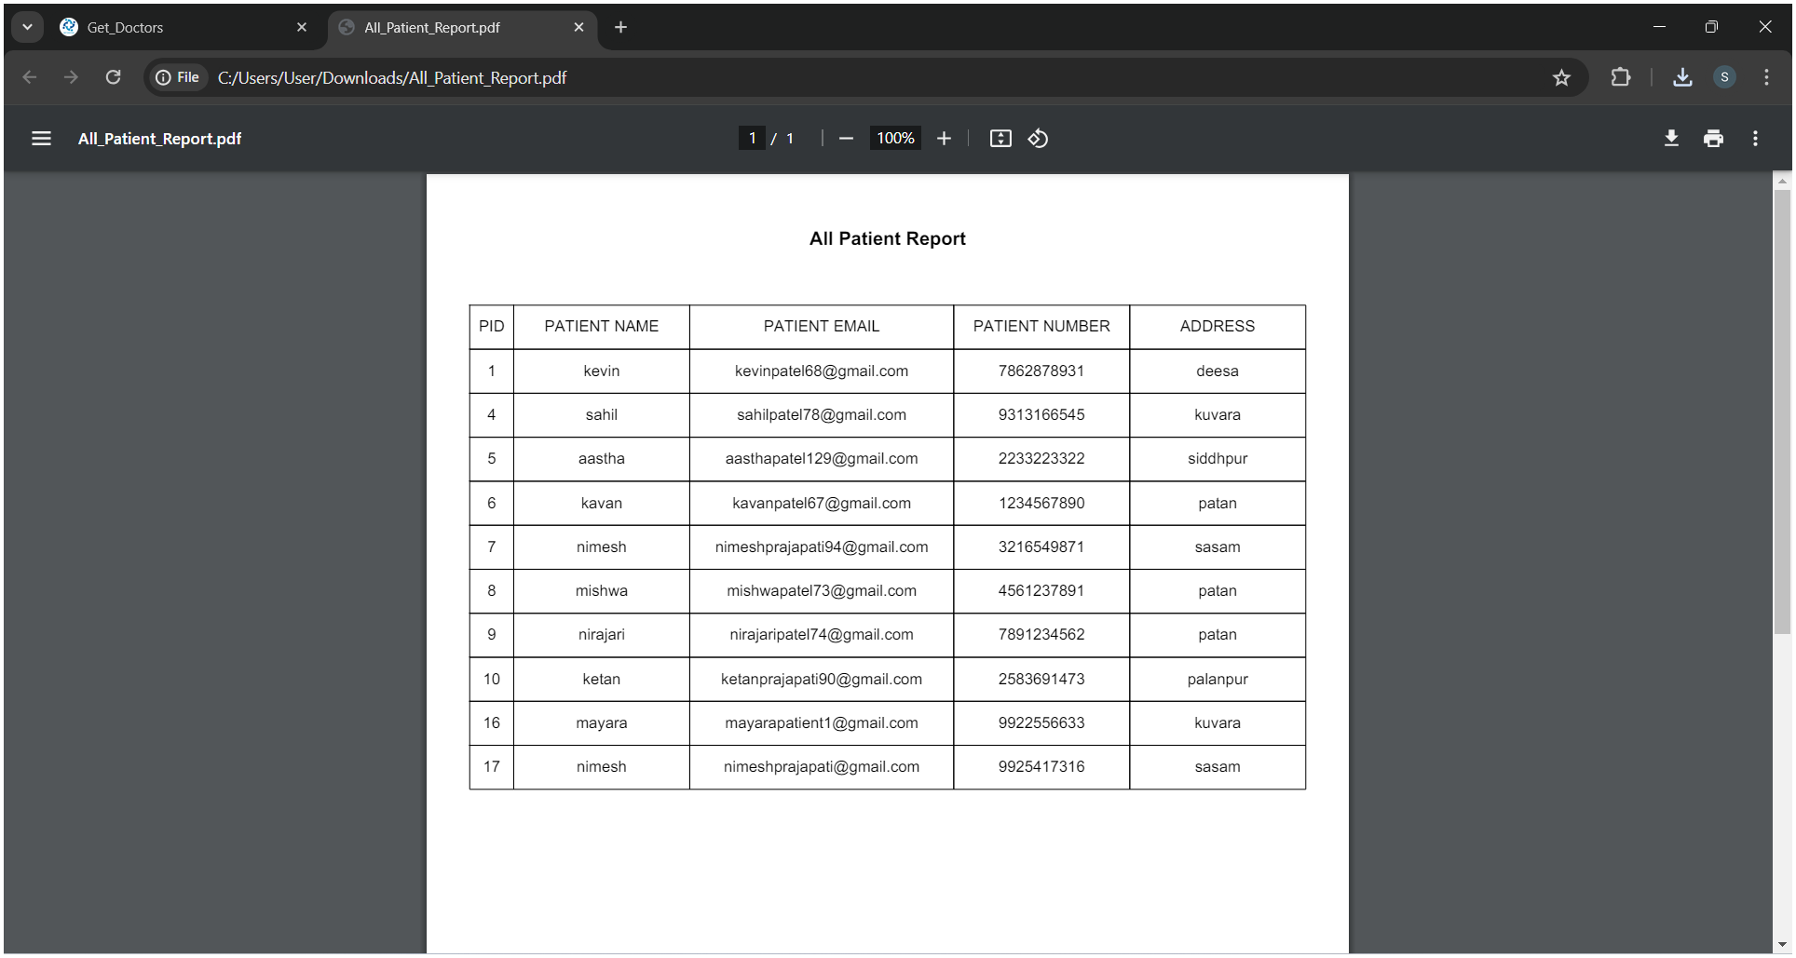
Get_Doctors
All Patient Report Generate

Slide 47
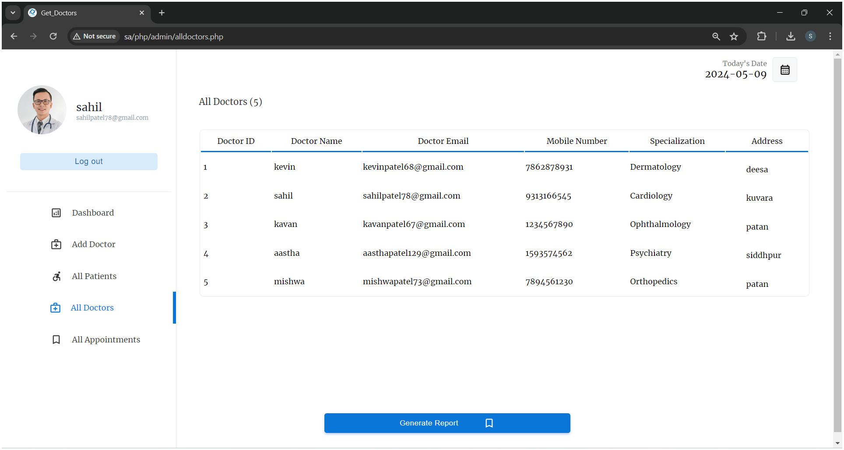
Get_Doctors
All Doctors

Slide 48
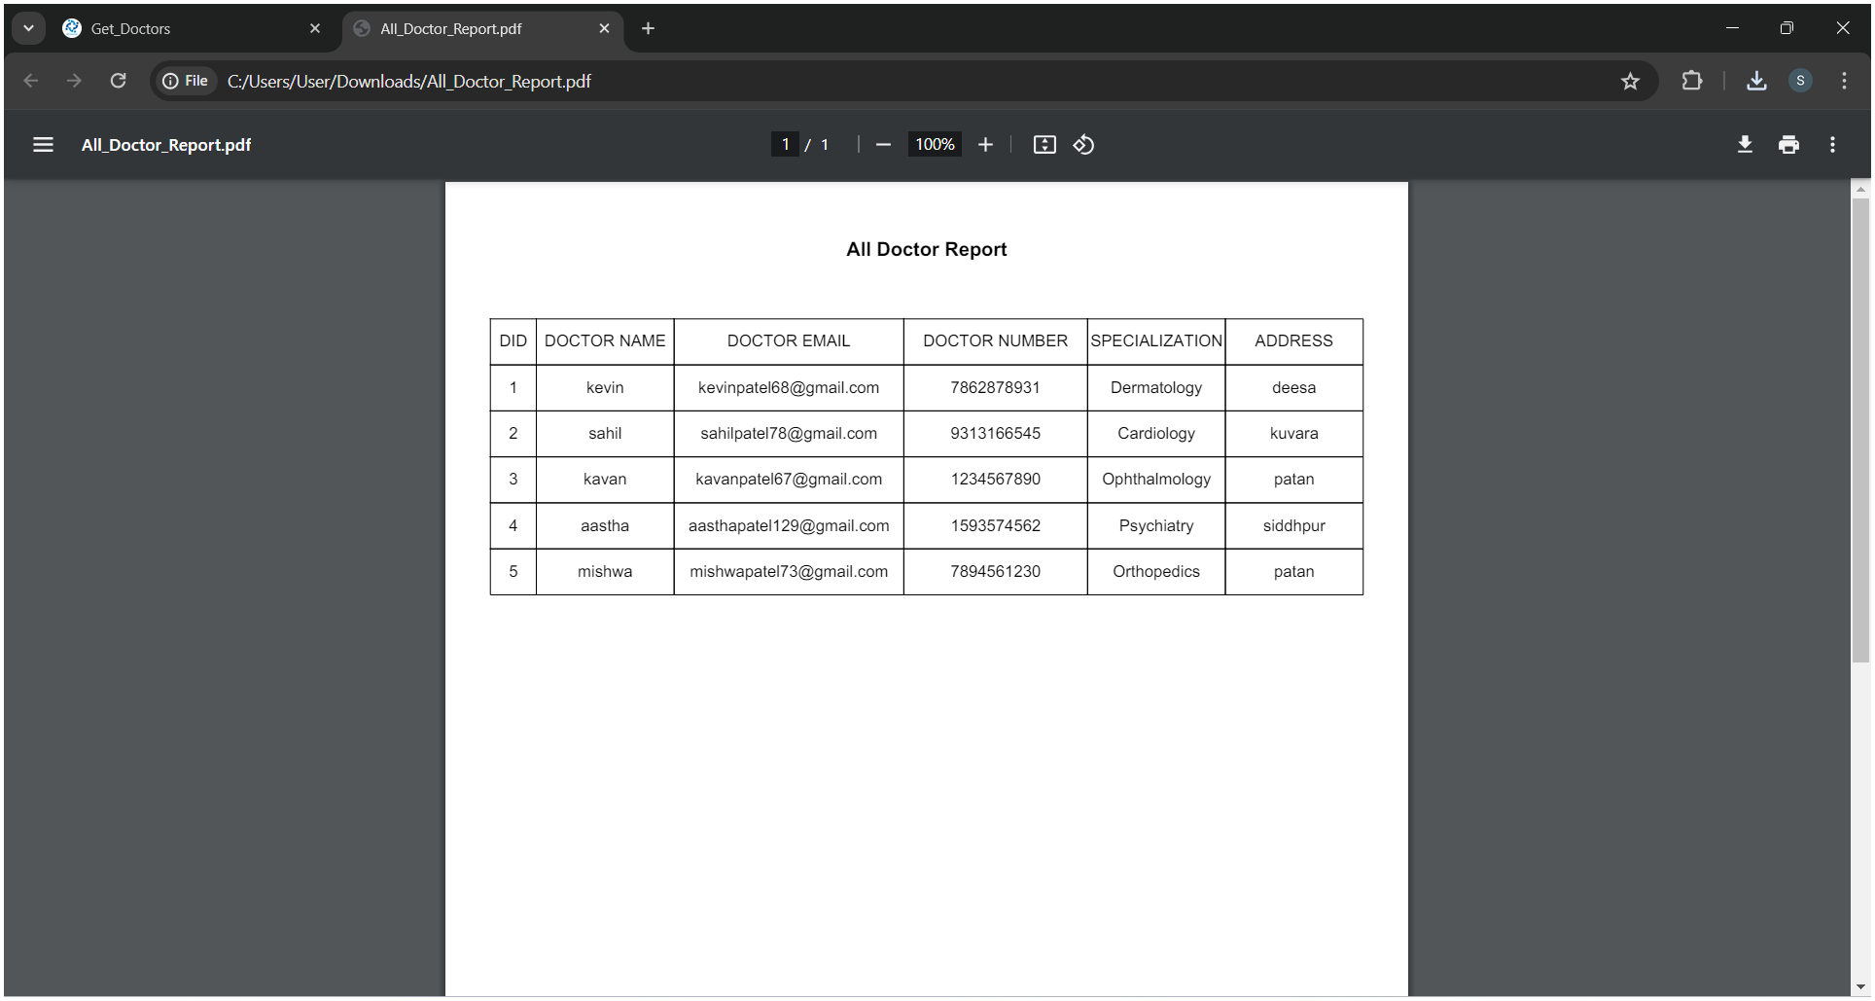
Get_Doctors
All Doctors Report Generate

Slide 49
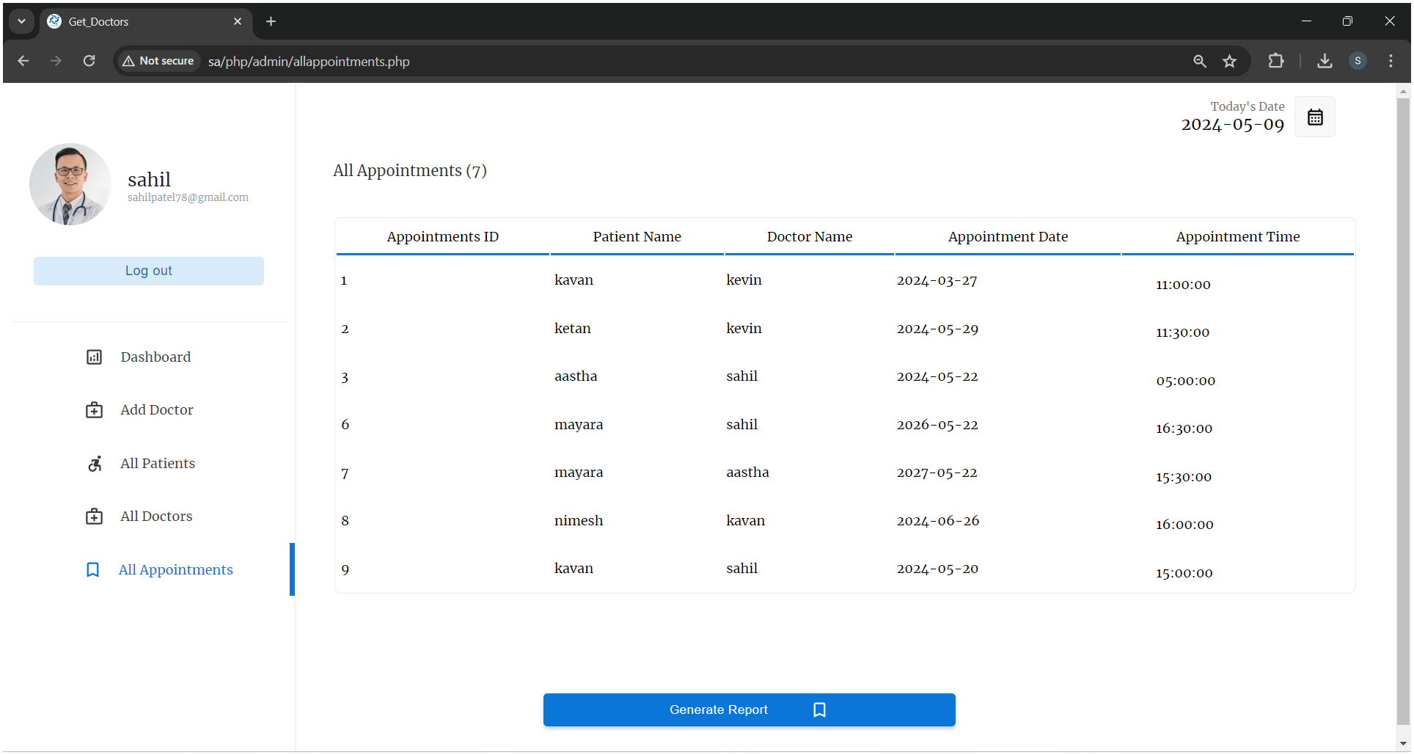
Get_Doctors
All Appointments

Slide 50
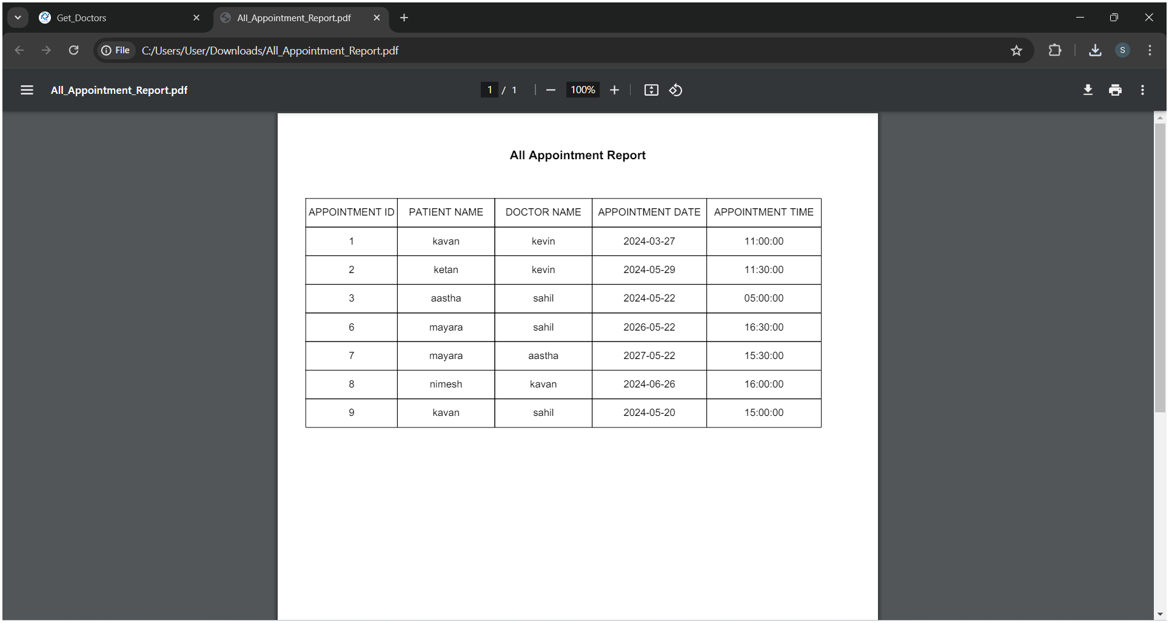
Get_Doctors
All Appointments Report Generate

Slide 51
Get_Doctors
Thank You

